Slide 1
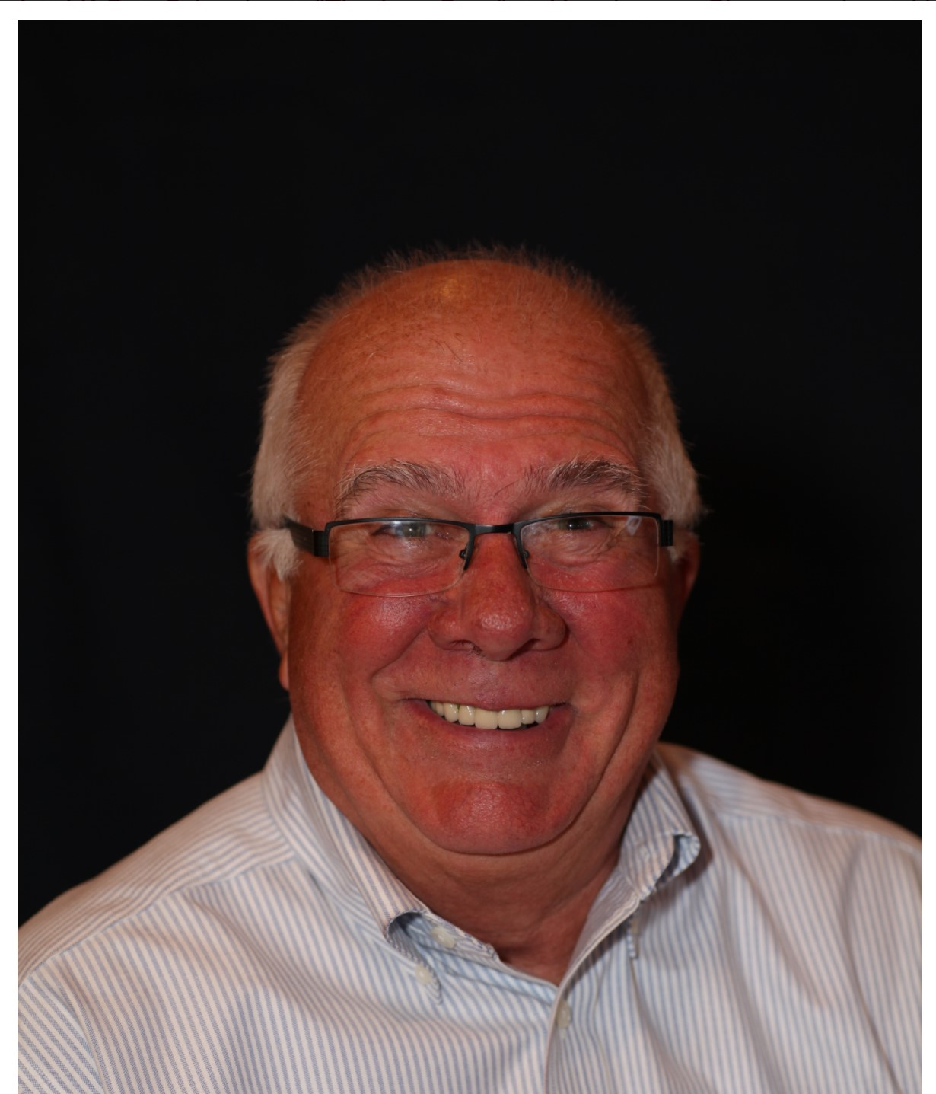
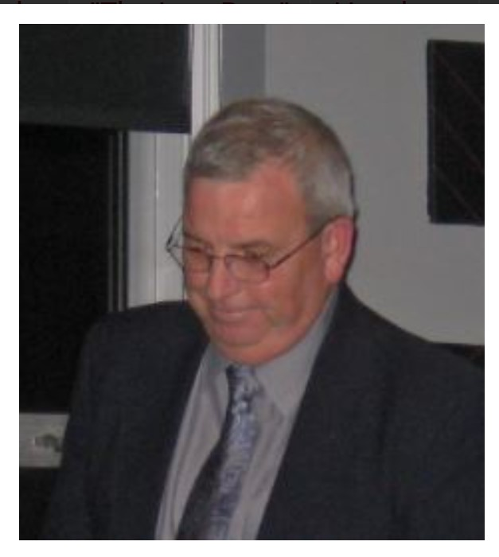
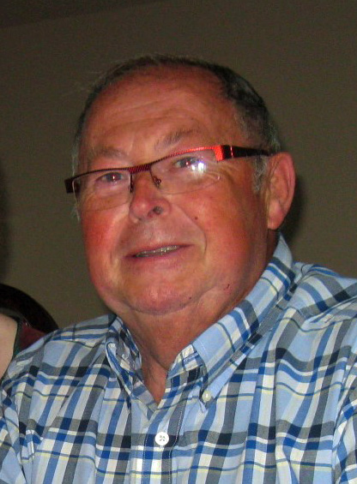
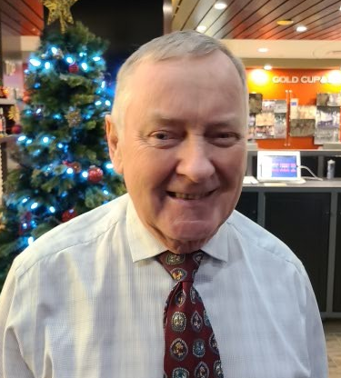
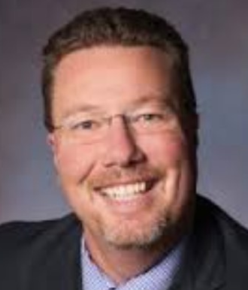
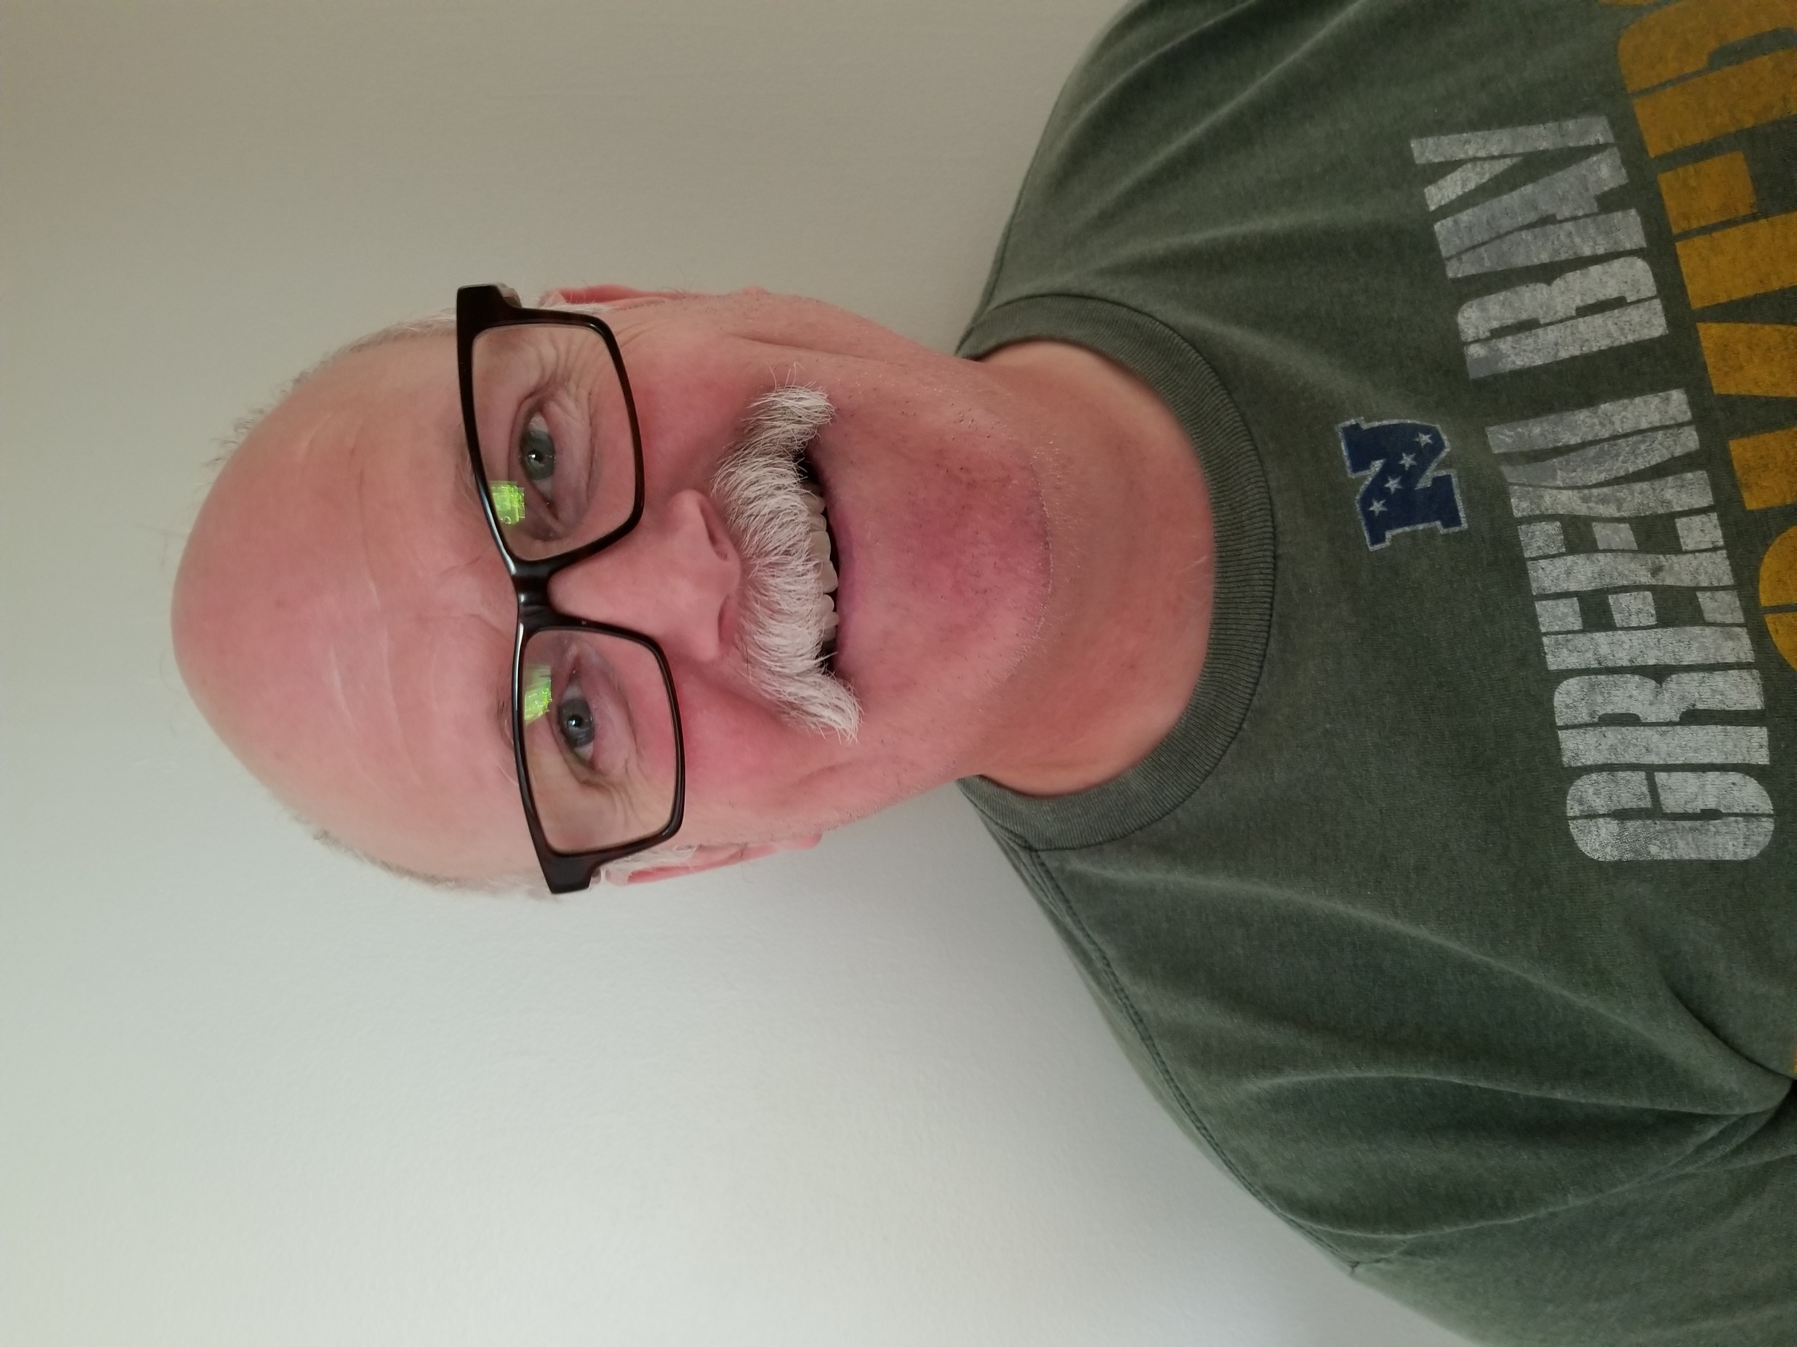
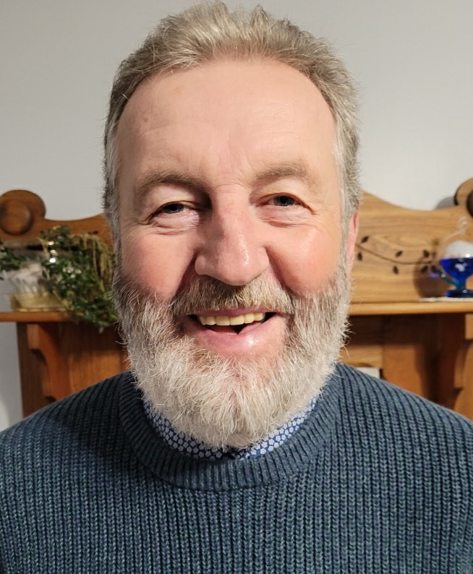
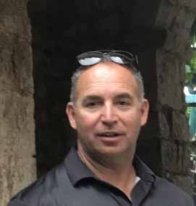
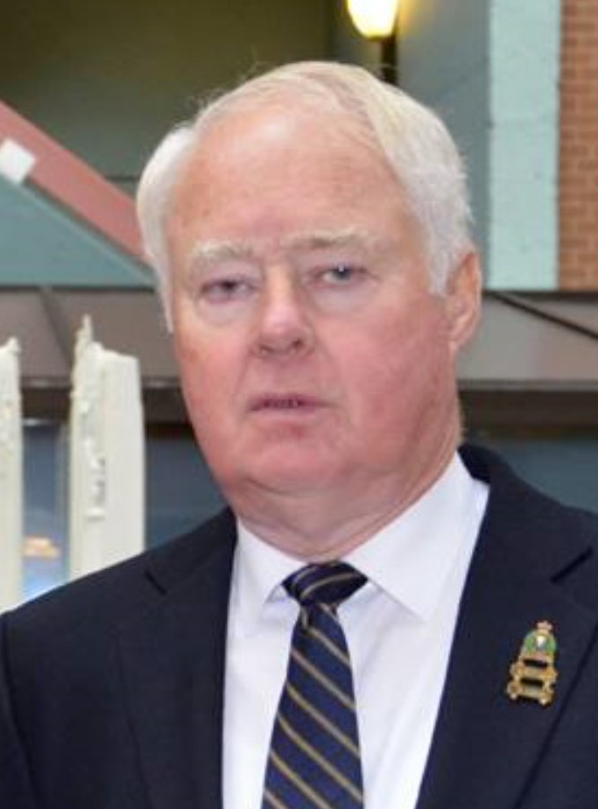
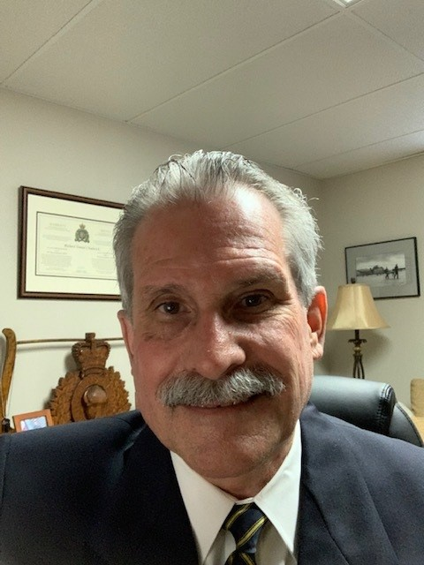
Top Row: President Phil Pitts; 1st VP Brian Weldon; 2nd VP Robert MacDougall, Secretary Lew Robinson, Treasurer Ian Gemmell, Past President Scott Ferris; and Bottom Row: Director Kings Ray MacCormack, Director Queens Dan D’Amour, Director Prince Harold Hodgin, Entertainment (TBD), Membership, Credentials and Database Ernie MacAulay, and Advocacy Rick Chadwick.

